Slide 1
[insert logo here]
Care Navigation
What's that when it's at home?

Slide 2
[insert logo here]
Care Navigation
What's that when it's at home?

Slide 3
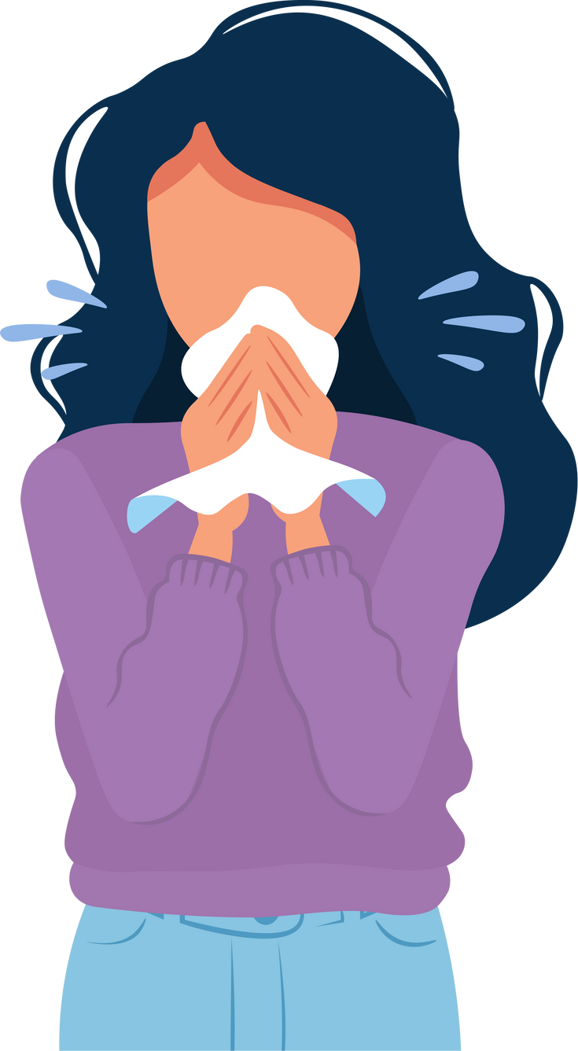
[insert logo here]
Not feeling well?

Slide 4
[insert logo here]
Not feeling well?

Slide 5
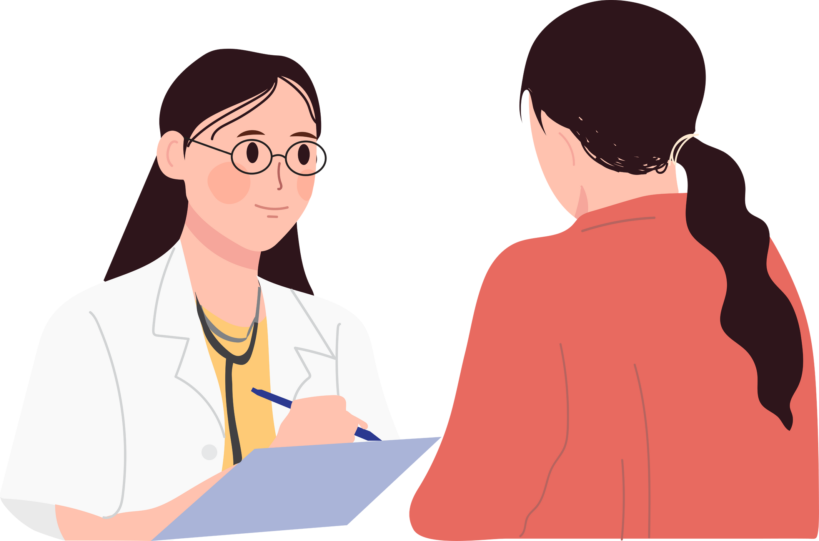
[insert logo here]
When you feel ill and ring your GP practice, you just want to see someone fast so that you can feel better again.

Slide 6
[insert logo here]
When you feel ill and ring your GP practice, you just want to see someone fast so that you can feel better again.

Slide 7
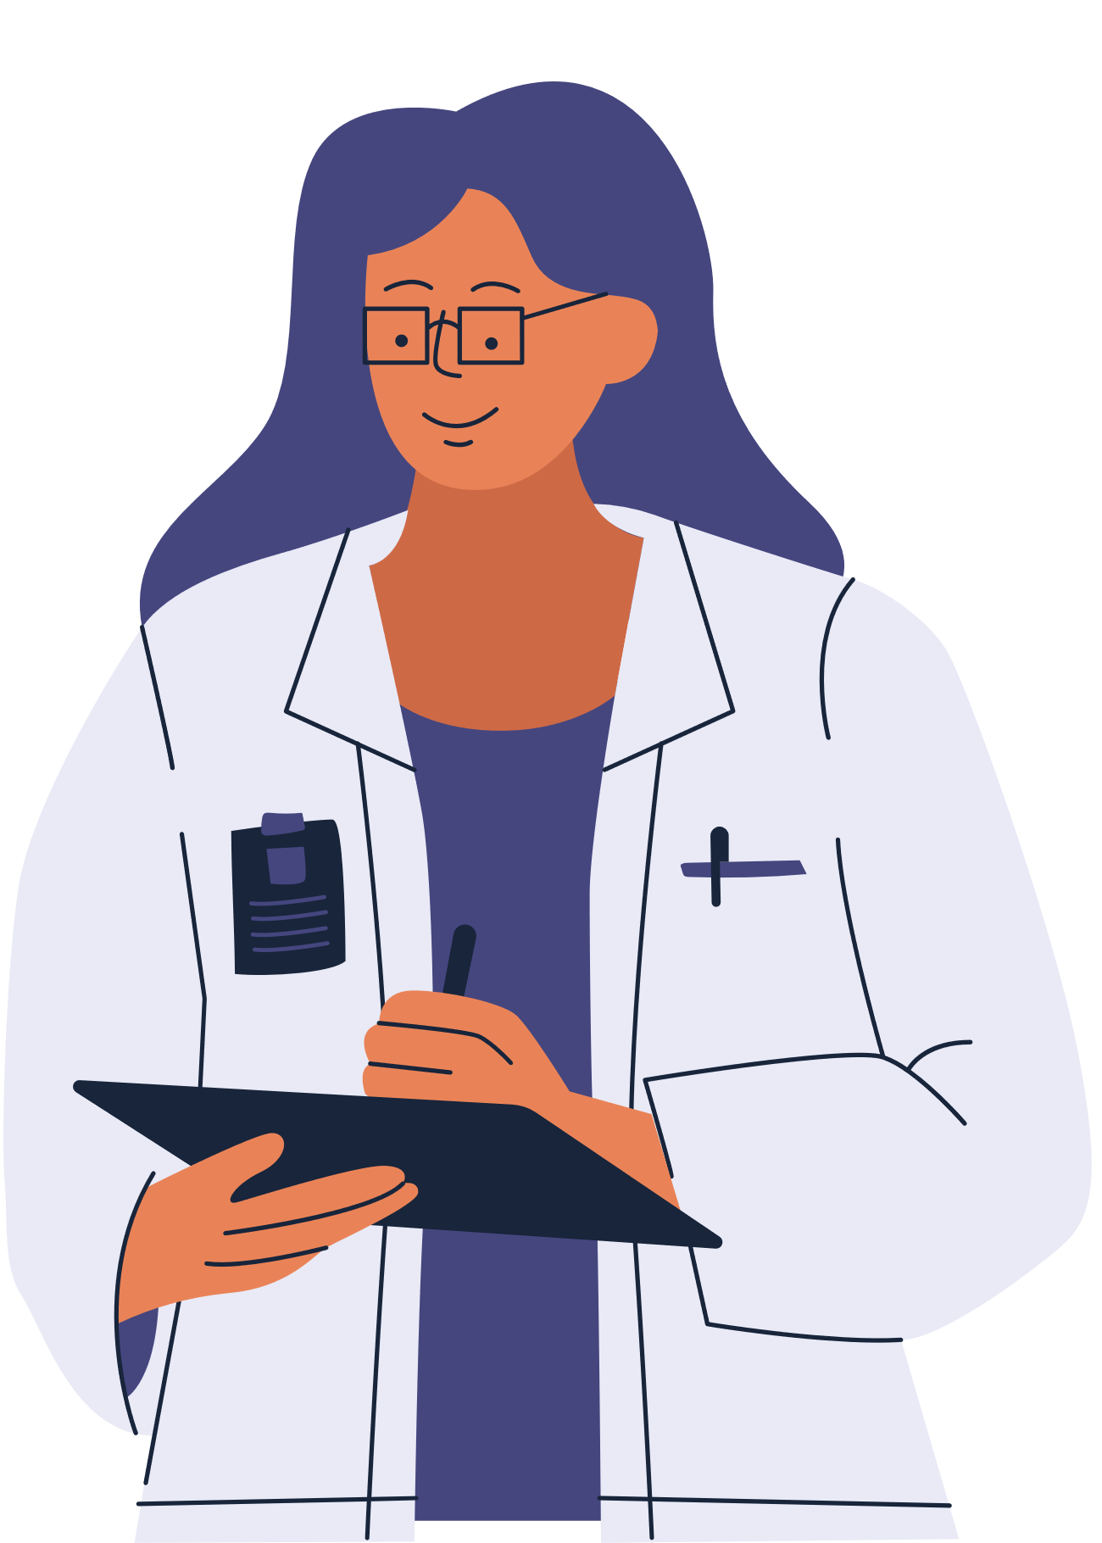
[insert logo here]
Sometimes though, the GP isn't really the best person to see.

Slide 8
[insert logo here]
Sometimes though, the GP isn't really the best person to see.

Slide 9
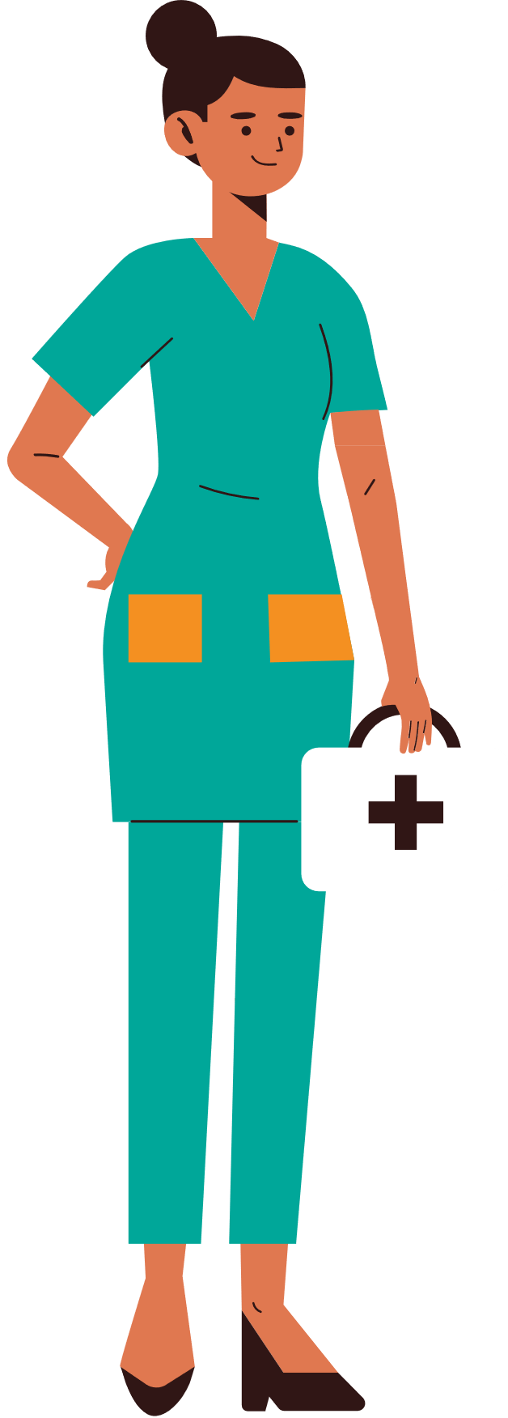
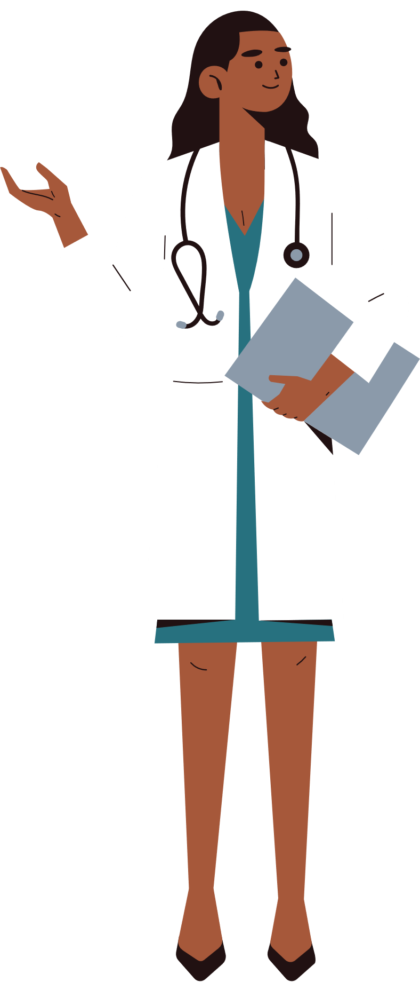
[insert logo here]
It could be the pharmacist, a mental health nurse, a social prescriber or the physiotherapist.

Slide 10
[insert logo here]
It could be the pharmacist, a mental health nurse, a social prescriber or the physiotherapist.

Slide 11
[insert logo here]
In some cases, the GP practice might not be the right place at all.

Slide 12
[insert logo here]
In some cases, the GP practice might not be the right place at all.

Slide 13
[insert logo here]
Introducing Care Navigation!

Slide 14
[insert logo here]
Introducing Care Navigation!
Forget the fancy title. It's simply about getting you to the right service fast.

Slide 15
[insert logo here]
Introducing Care Navigation!
Forget the fancy title. It's simply about getting you to the right service fast.

Slide 16
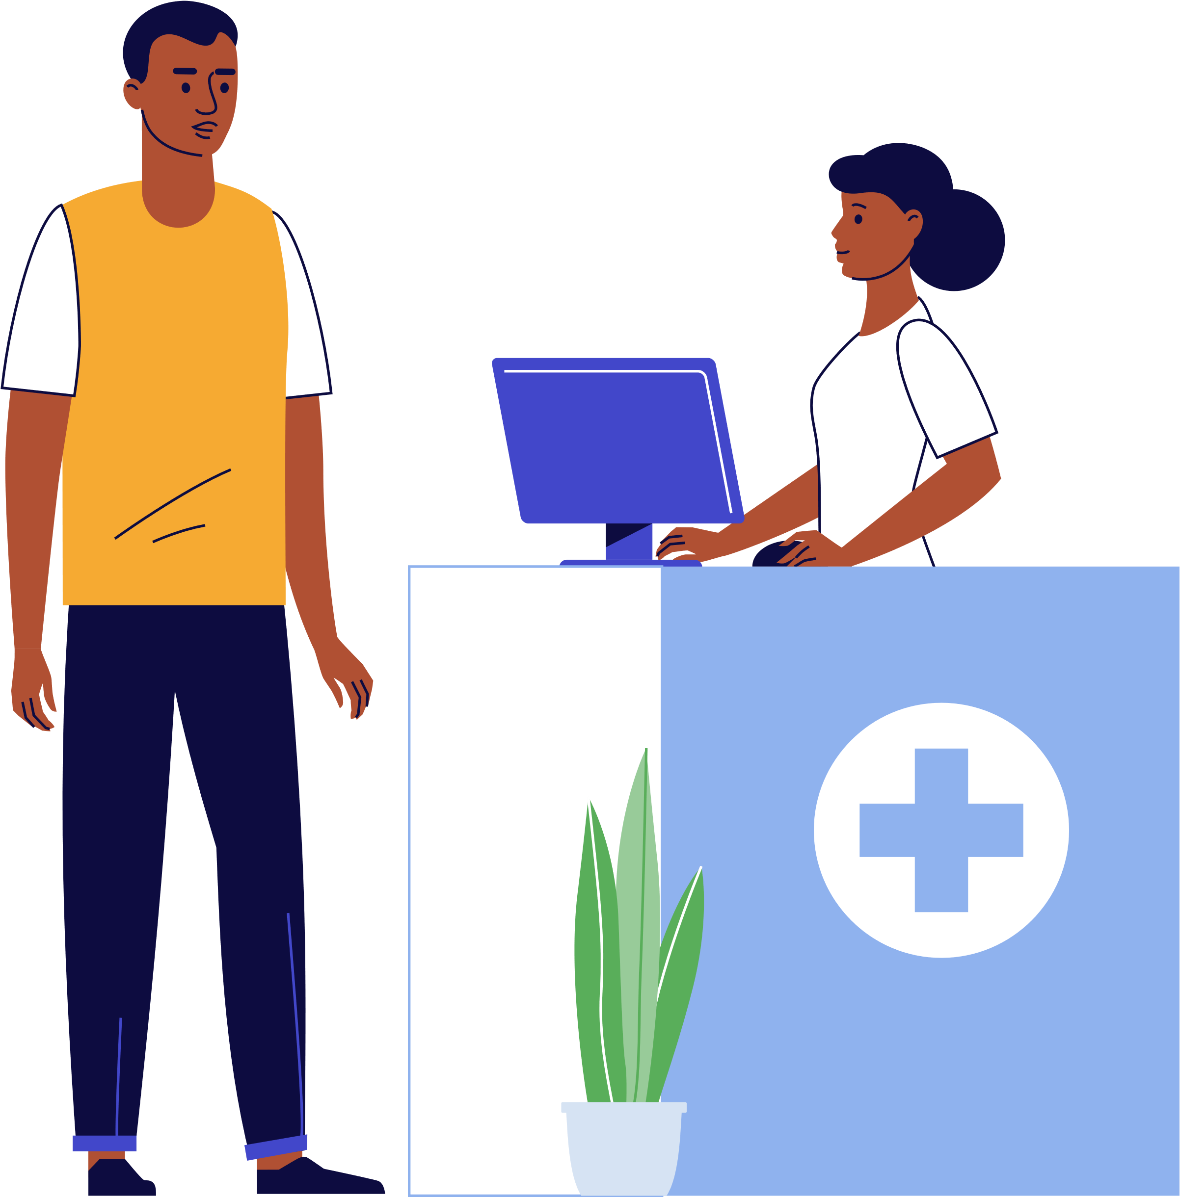
[insert logo here]
I just want to feel better
So, when you call the GP practice, most receptionists are now trained to navigate you to the best person to help you.

Slide 17
[insert logo here]
I just want to feel better
So, when you call the GP practice, most receptionists are now trained to navigate you to the best person to help you.

Slide 18
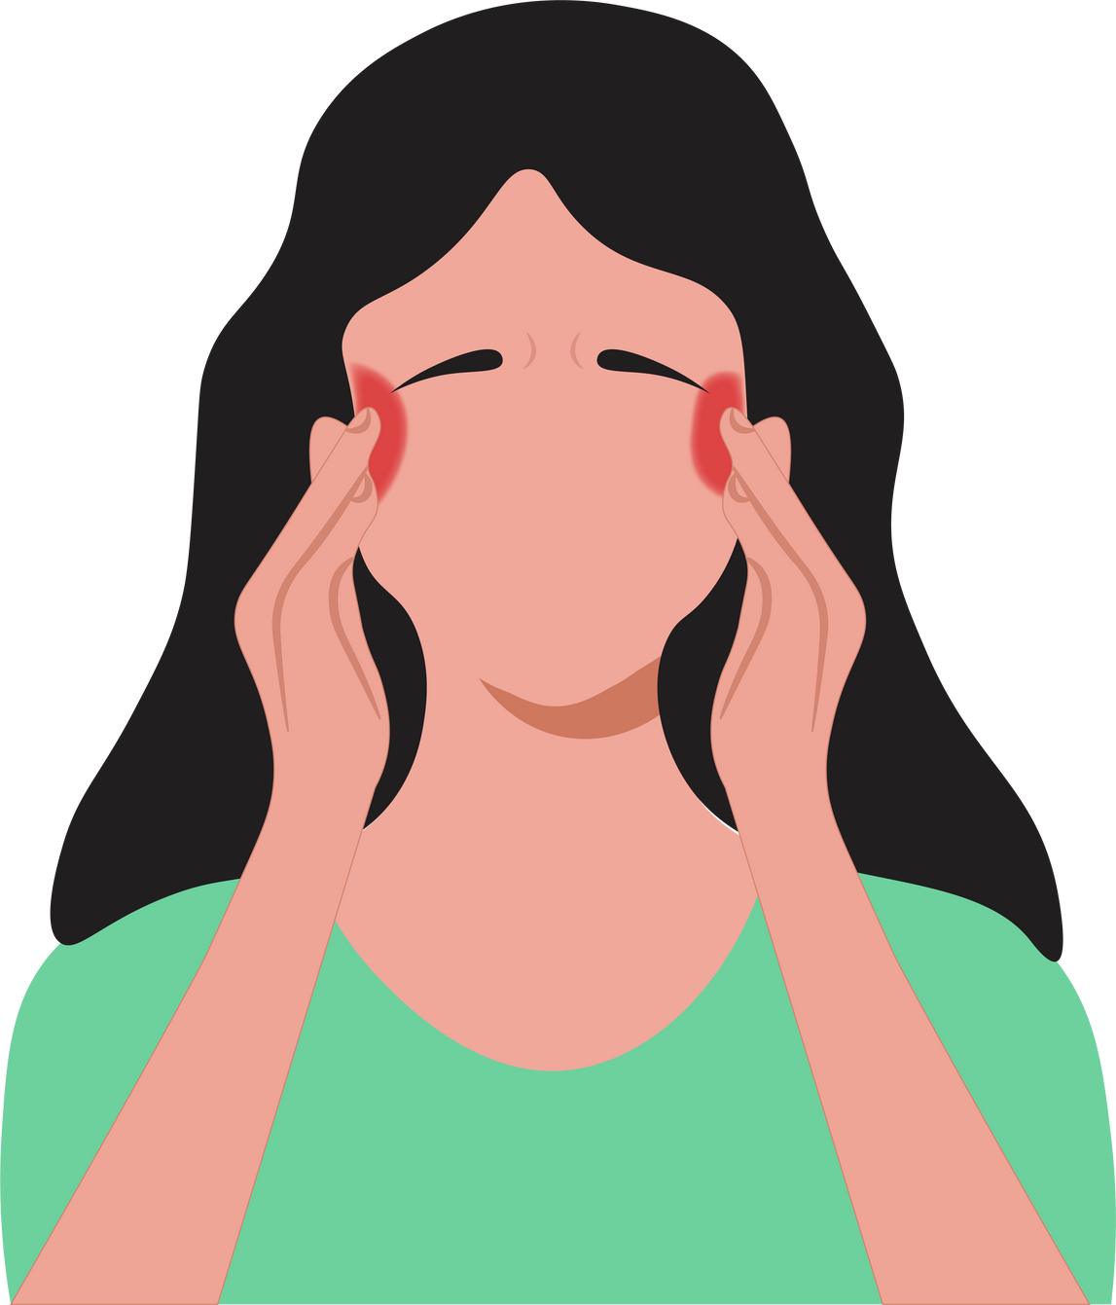
[insert logo here]
They won't try to diagnose your problem or be a superhero, but your problem could be solved faster and better, if you tell them a little about why you're calling today.

Slide 19
[insert logo here]
They won't try to diagnose your problem or be a superhero, but your problem could be solved faster and better, if you tell them a little about why you're calling today.

Slide 20
[insert logo here]
You don't have to of course, but by doing so there's more choice and you'll be seen by someone that can help you faster.

Slide 21
[insert logo here]
You don't have to of course, but by doing so there's more choice and you'll be seen by someone that can help you faster.

Slide 22
[insert logo here]
Thanks to Care Navigation.

Slide 23
[insert logo here]
Thanks to Care Navigation.

Slide 24
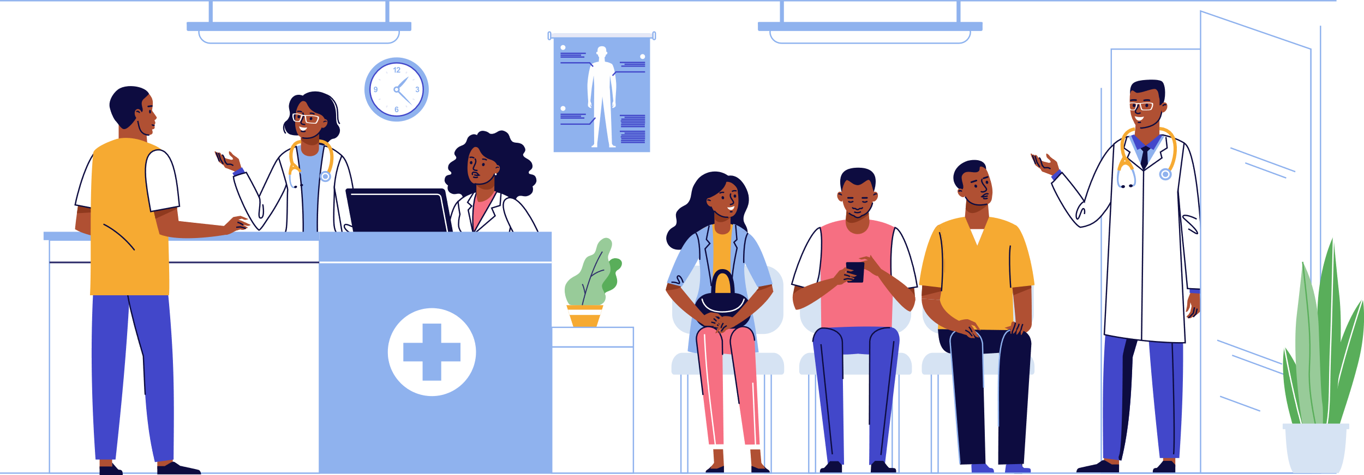
2023 Conexus Healthcare
[insert logo here]
Ask your GP practice about it today

Slide 25
2023 Conexus Healthcare
[insert logo here]
Ask your GP practice about it today

