Slide 1
Care Navigation
Communications Toolkit for GP Practices

Slide 2
Conexus Healthcare is the GP confederation (group of GP practices) for all practices in the Wakefield District and proud providers of the UK's leading care navigation training programme. www.conexus-healthcare.org
Copyright - Conexus Healthcare Ltd 2022.
[Insert Logo Here]

Slide 3
Ready to promote care navigation at your practice?
Great communications and engagement are vital from the start. You can guide patients through this new approach using the examples and templates contained in this guide.
Contents
Care Navigation in a nutshell..................................................................
Press..........................................................................................................
Voice message.....................................................................................
Posters & leaflets......................................................................................
TV screens................................................................................................
Text message...........................................................................................
Website....................................................................................................
Social media.............................................................................................
Practice newsletter...................................................................................
page 3
page 4
page 5
page 6
page 7
page 7
page 8
page 9
page 9
[Insert Logo Here]

Slide 4
Care Navigation in a Nutshell
Sometimes, the GP isn’t really the best person to see when we visit our GP practice.
Patients could be seen and treated more quickly by a nurse or a physiotherapist for example and in
some cases, the GP practice might not be the right place at all for our query. That’s where ‘active signposting’ or ‘care navigation’ as we call it comes in.
Care navigation is just one of the ways that practices up and down the country are making better use of their practice team and wider primary care teams. This is so we can support patients to quickly and easily access the most appropriate service for their needs.
Since Conexus started delivering care navigation training, we've heard from hundreds of practices and patients about their experiences in seeing someone other than the GP. The
majority of patients say that 'getting the right treatment quickly' is most important to them.
Patients look to GPs and nurses for reassurance about their health. Use this trust to explain promote care navigation clearly and your patients are more likely to understand the
benefits and welcome the new approach. Many practices that we've trained have found this approach works best.
It's also good to find a way to explain care navigation without using the term itself. In the beginning patients may not understand what it entails. You'll find a range of examples throughout this guide to help you find the right way to promote care navigation in your practice.
If you have any questions or comments about the toolkit or how to implement the materials in your practice, please contact: carenavigation@conexus-healthcare.org.
[Insert Logo Here]

Slide 5
Voice Message
It is important to let patients know about the changes brought about by care navigation before they start.
One great method to give patients the heads up is by recording a voice message for your practice phone line.
The messenger is the most important factor in this communication. Patients feel more confident hearing from their GP and receptionists feel more confident to care navigate if the GP has recorded the message. It’s also great for patients who don’t visit the practice often and may be unaware of the new process.
Depending on your systems and set up for automated telephone appointments, please consider where you may need to reinforce the message about alternative services.
Encourage one or two GPs to record the message with wording along these lines:
“Hello my name is Dr ______ and I am the senior partner at ______ surgery.
You will shortly be put through to our reception staff. We have asked them to ask you if you wouldn’t mind telling them a little about the problem you are calling about today.
This is simply so they can direct you to the person who would be most suitable
to help you with your problem.
Of course, you don’t have to do this, but it would help us to help you and ensure
you see the right person, first.
Thank you very much.”

Slide 6
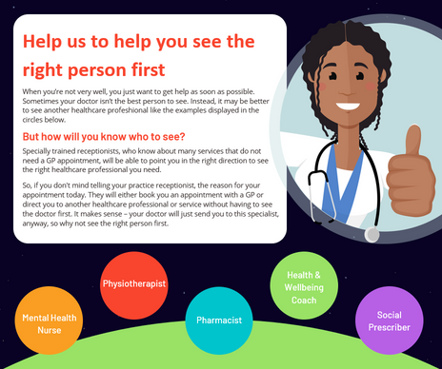
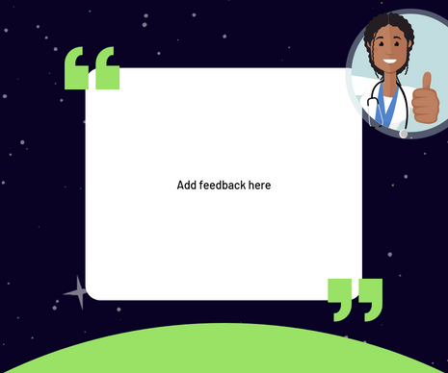
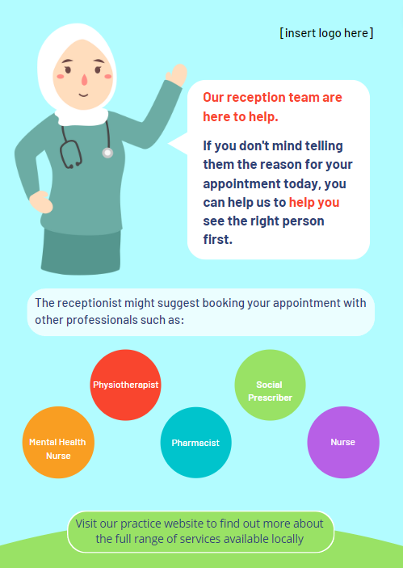
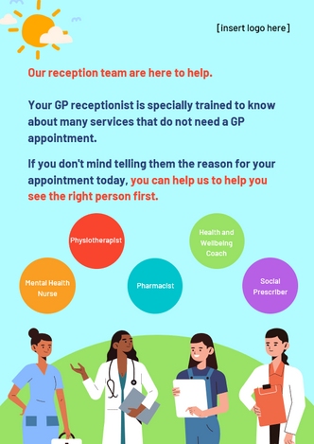
Posters & Social Media Posts
Putting up posters around your waiting room and reception area is quick and easy way to raise awareness of care navigation and the changes to the way your patients will interact with the reception team.
Below are a range of examples of posters and Social Media Posts that have been produced up and down the country. You will find these resources within the file you have been given access to.
[Insert Logo Here]

Slide 7
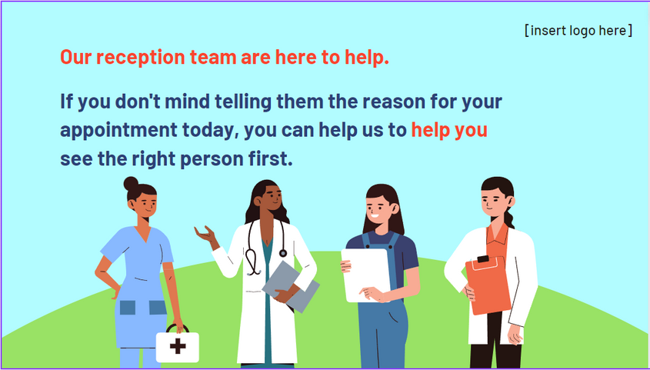
TV Screens
TV screens in your reception areas are the perfect place to advertise new campaigns and changes to your services.
If you use these to get information to your patients, please feel free to use the slide included in the resource pack which you have been given access to. This has been produced in Microsoft PowerPoint and is also provided as an image file.
There is also a care navigation animation which you are free to download and use.
[Insert Logo Here]

Slide 8
Text Message
Already using text messaging to send important information and appointment reminders?
It’s a great way to communicate with patients and is successful in reducing ‘no shows’ and raising awareness of various campaigns and
updates.
To the right is some simple text message wording, you may like to use when you first introduce care navigation.
Hello, It's Dr (NAME) from (PRACTICE NAME). Next time you call or visit us, our reception staff may ask if you wouldn't mind telling them the reason for your appointment. Please don't be offended - this is simply so they can direct you to the best person that can help you in our team. Thanks for your support with this.
[Insert Logo Here]

Slide 9
Website
Social Media
You need to make sure that messaging about care navigation is consistent across all platforms. Some patients might never call the practice and may only visit when they have an appointment.
Your practice website is often the first port of call for those patients who choose to access information online.
Depending on the functionality of your website, it is a good idea to include a banner and/or some information about care navigation, alerting patients to the changes they might notice before they book an appointment.
To the right is suggested wording which may be helpful for you to use or amend before adding to your website.
‘Help us to help you'
Did you know, there are a range of services and trained health professionals working closely with your GP that might be better suited to help you?
The next time you make an appointment at (PRACTICE NAME), you may be asked some questions about the reason for your appointment. Please don’t be offended – this is simply so that we can make sure you see the person who is most suitable to help you.
Of course, you don’t have to do this, but it would help us to help you and ensure you see the right person, first.
Thank you very much
If you have a Facebook or Twitter account this is an ideal opportunity to promote care navigation and list some of the alternative services a patient may be navigated to.
The more people involved online, the further you can spread the message about the benefits to
patients.
Below are some great social media videos we've come across from other areas that may inspire you to create your own:
To open the link, left-click on the below text and select ‘open link’
Dr Olivia
Kaitlyn's Cold
[Insert Logo Here]

Slide 10
Practice Newsletter
If you send regular patient newsletters, these provide another great platform to get the message out about care navigation.
Feel free to take inspiration from this example to your right. Taking a ‘chatty’, more relaxed tone works well in a newsletter and you can make this specific to your practice and the services available to your patients.
In the 50s when our grandparents visited their doctor, they would probably have been greeted by a receptionist and had access to one, maybe two, doctors. How things have changed!
Now your GP surgery hosts a diverse team made up of doctors, nurses, healthcare assistants, nutritionists, paramedics, physiotherapists, phlebotomists, occupational therapists and social workers. The list is endless and ever-expanding as we invest in more professionals and services that are there to help you.
When you visit your GP surgery, it is important that you see the right person for your needs. Of course, an appointment with your doctor will always be available to you, but there may be someone more able to help you straight away, without a referral.
When you next call or pop in to book an appointment at the surgery, you may be asked about
the nature of your need. We’re not being nosey, and we still respect your privacy and right to say no. Help us to help you see the right person, first.
[Insert Logo Here]

Slide 11
How to add your Logo
You will notice on every page in your package that there is a section with ‘[Insert Logo Here]’ which is where we recommend the best place for you to add your Practice or PCN logo. We recommend adding your logo to everything as it builds your patient’s loyalty with the content they are reading.
Grab your logo which should be saved as a JPEG or PNG and drag it from the file onto the PowerPoint
Move your logo to the size you would like it to be
Then replace the [Insert Logo Here] with your logo
[Insert Logo Here]

Slide 12
How to export your files to a PDF
If you are wanting to print off your booklet or anything else in the package, (if it does not allow you to print through PowerPoint) we suggest you export your PowerPoint file into a PDF to print.
To do this click -
Then name your file and click on the folder you would like to save it in and click Publish.

